Slide 1
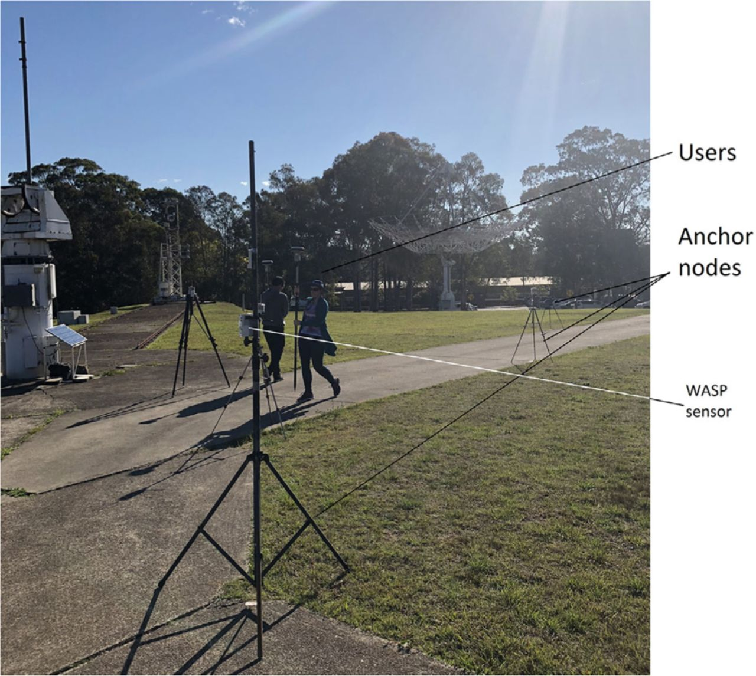

Data collection area with anchor nodes set up around the improvised road.
Jelena Gabela et al. navi 2021;68:333-351
Copyright © 2021 Institute of Navigation
Notes:
Data collection area with anchor nodes set up around the improvised road

